Slide 1


Worry is associated with the overuse of model-based revaluation
The role of overthinking in goal-oriented planning
Adi Pizanti, Paul B. Sharp
Notes:
Hey everyone, I’m Adi, a first year MA student from bar ilan university doing research under sharp’s lab with
I’m very excited to be here today and present my work on worry
~

Slide 2
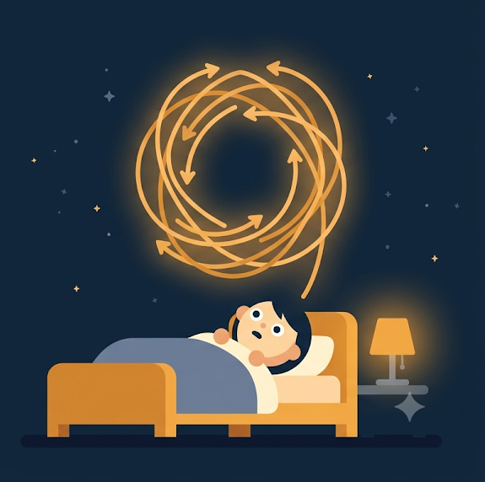
Notes:
Last night I was lying in bed, thinking about this moment. At first it went fine — the slides flow, the talk is clear. But then I started thinking about everything that could go wrong. I'd done everything I could to prepare, yet I kept returning to the same thoughts, over and over. In other words, I got worried.
Clinicians can tell that from a certain point, this kind of thinking is inefficient — we doubt our own conclusions and never reach an answer. But from the patient’s side, it feels like planning: thinking hard about the future, trying to prepare. If
that's true, we'd expect planning to change in some way with worry. And yet computational work has found no reliable relationship between worry and model-based planning.
We think part of the reason is how tasks in the field treat time. Previous approaches either ignore the time it takes to think — and its role in the decision itself — or use tasks so fast that variation in thinking time barely matters. So we set out to test whether planning differs in people who worry, using a paradigm that treats deliberation time as a direct window into the process.

Slide 3
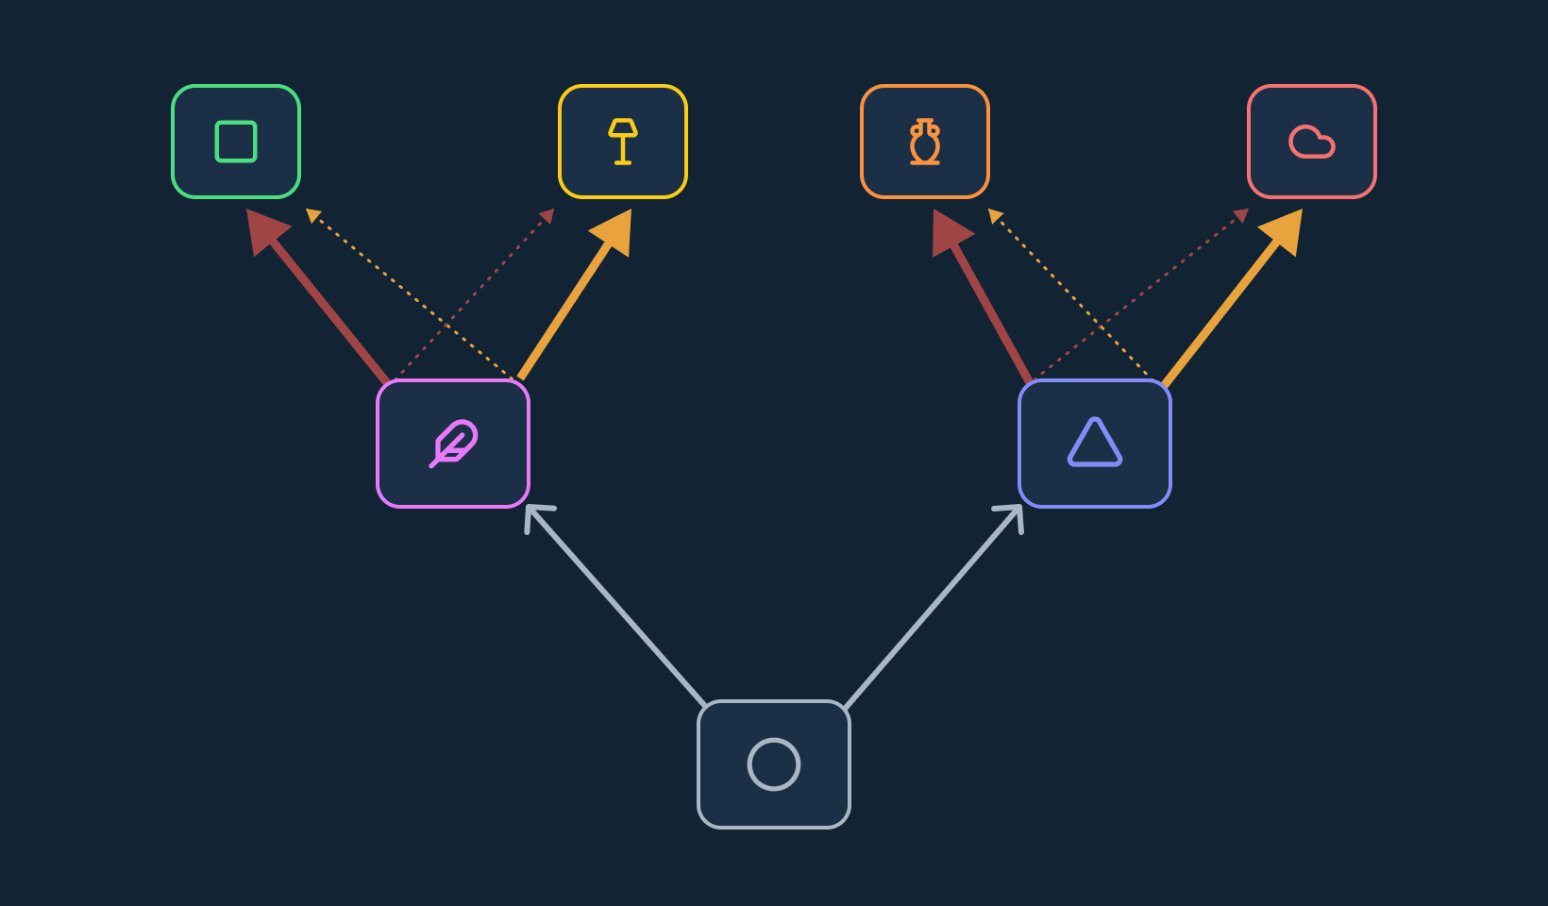
Structure Learning
End
Start
(Gershman et al., 2014)
Notes:
we used a retrospective revaluation task
First, people learn the map, which path leads where. The feather takes you one way, the triangle another.

Slide 4
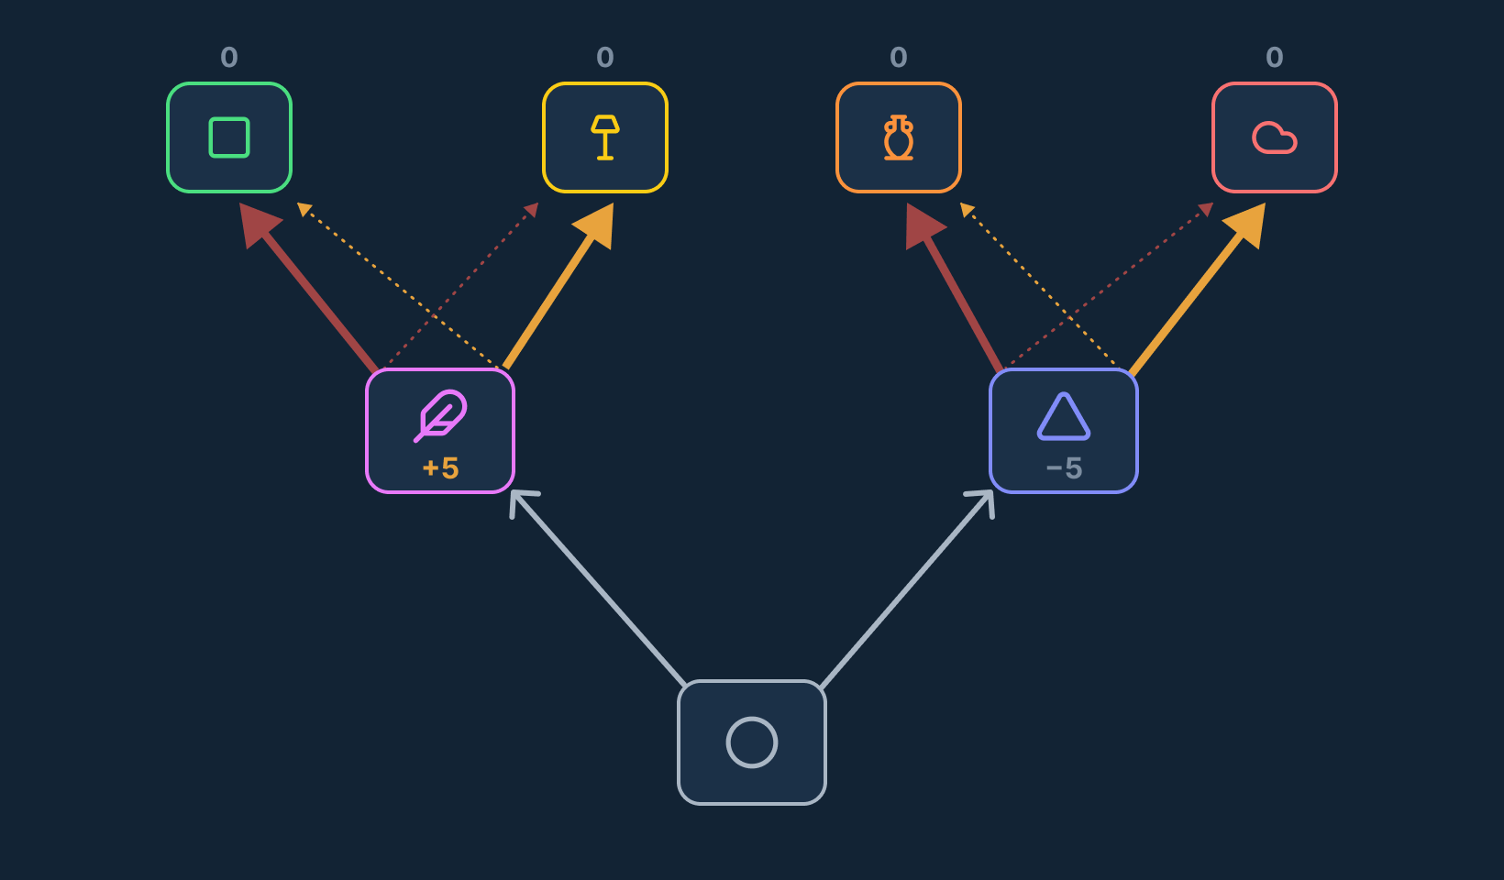
Value Learning
Notes:
Then they learn the rewards: the feather is a good option, gives you 5 points. triangle is a bad option, worth −5 points. Even though trials included the whole path, any of the final states has no values at this point
So participants develop a preffered path based on the middle states only

Slide 5
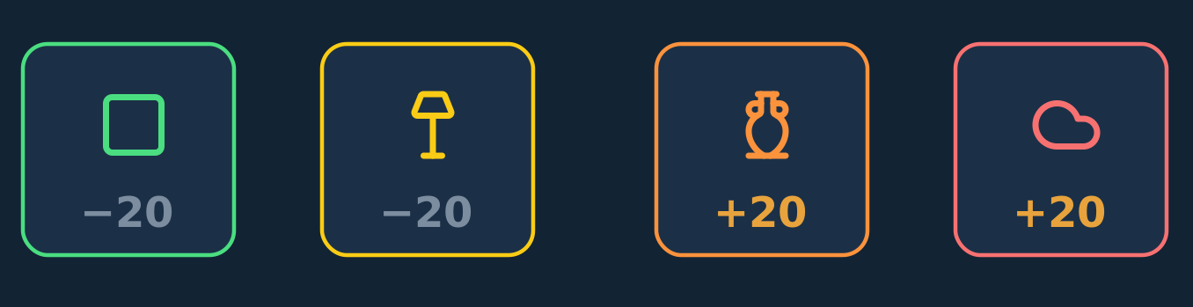
Revaluation
Notes:
Now the planning part. We change the values at the end of the paths. without letting participants activley moving through the environment anymore.
For the sake of time we will focus in the triangle path from now

Slide 6
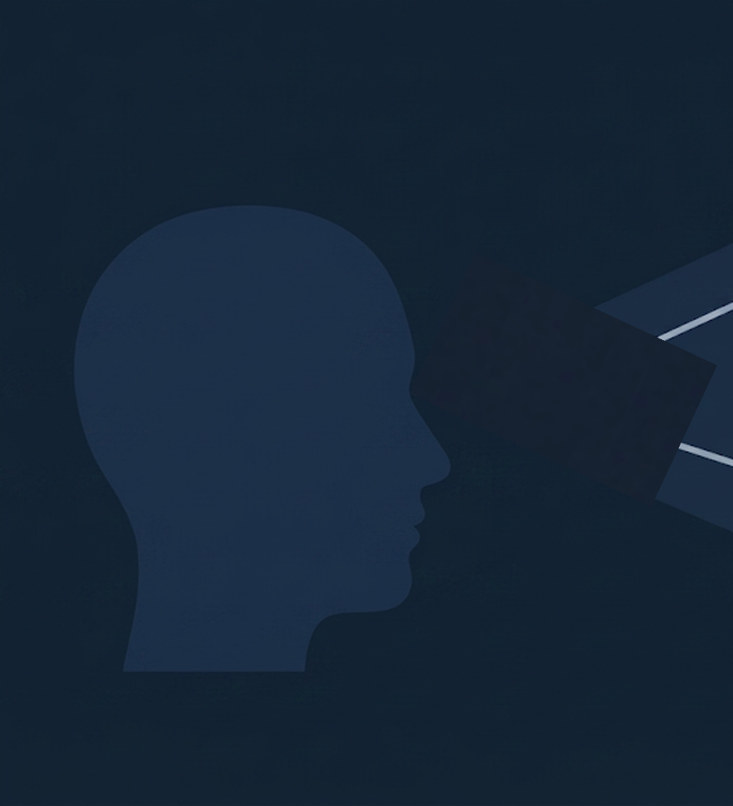
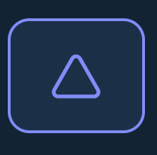
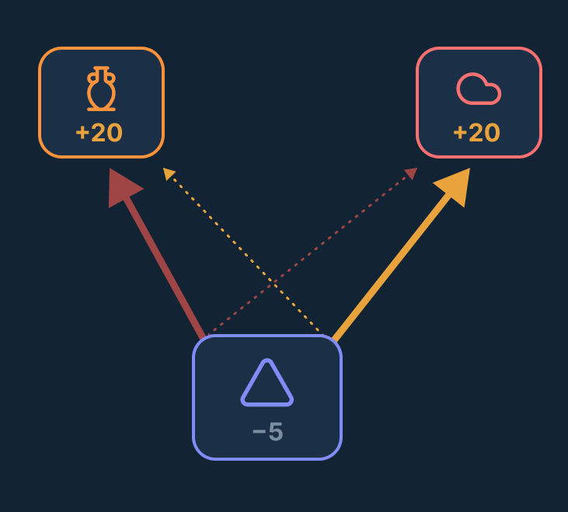

MB
MF
+15
=
=
-5
Notes:
In oreder to reevaluate paticipants had to succesfuly update their internal map wit the new values. Participant succesfuly updating map values are now seeing the triangle as a much better path than in was a moment before.
Participant who stick to the actual experience with the map will not update triangle’s value accroding to new values presented

Slide 7
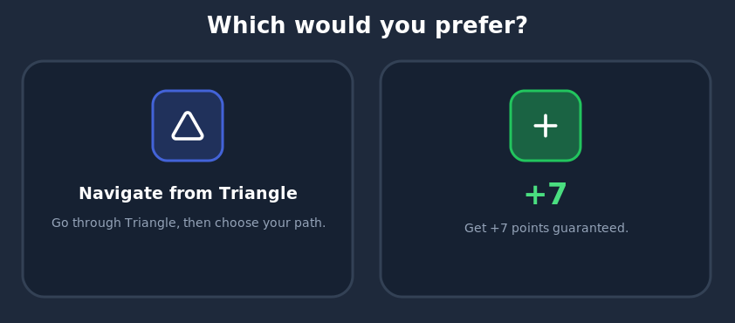
Query
MB
MF
=
+15
=
-5
Notes:
So after revealing those end states values participants are given a variety of binary choices like the one you see on the screen.
would you rather go through the triangle, or take +7 for sure?
Participant’s choices enables us to split our sample to MB and non-MB learners.

Slide 8
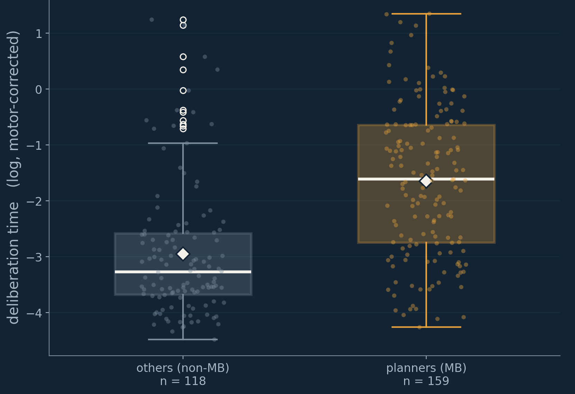
Who used MB?
Model-agnostic
(>50% queries MB)
Model as Random (Payam Piray)
MF
MB
Notes:
Half of our sample was MB, and we verified this in two ways.
We also varified that MB participants actually deliberate longer. Which align with the fact that the MB system uses heavier computations that MF

Slide 9
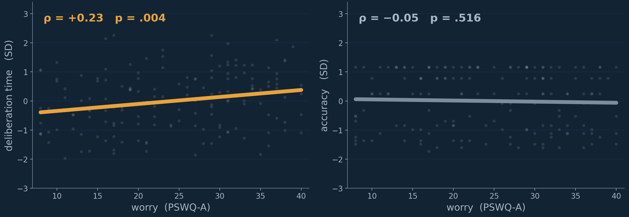
Worry and overthinking in MB users (N=158)
deliberation
accuracy
Notes:
And more specifically, among MB participants, worry and deliberation time positively correlate while accuracy stayed the same. This finding is exclusive to MB participants
Meaning that among people who plan, worriers deliberate more but doesn’t get any benefit from it.

Slide 10
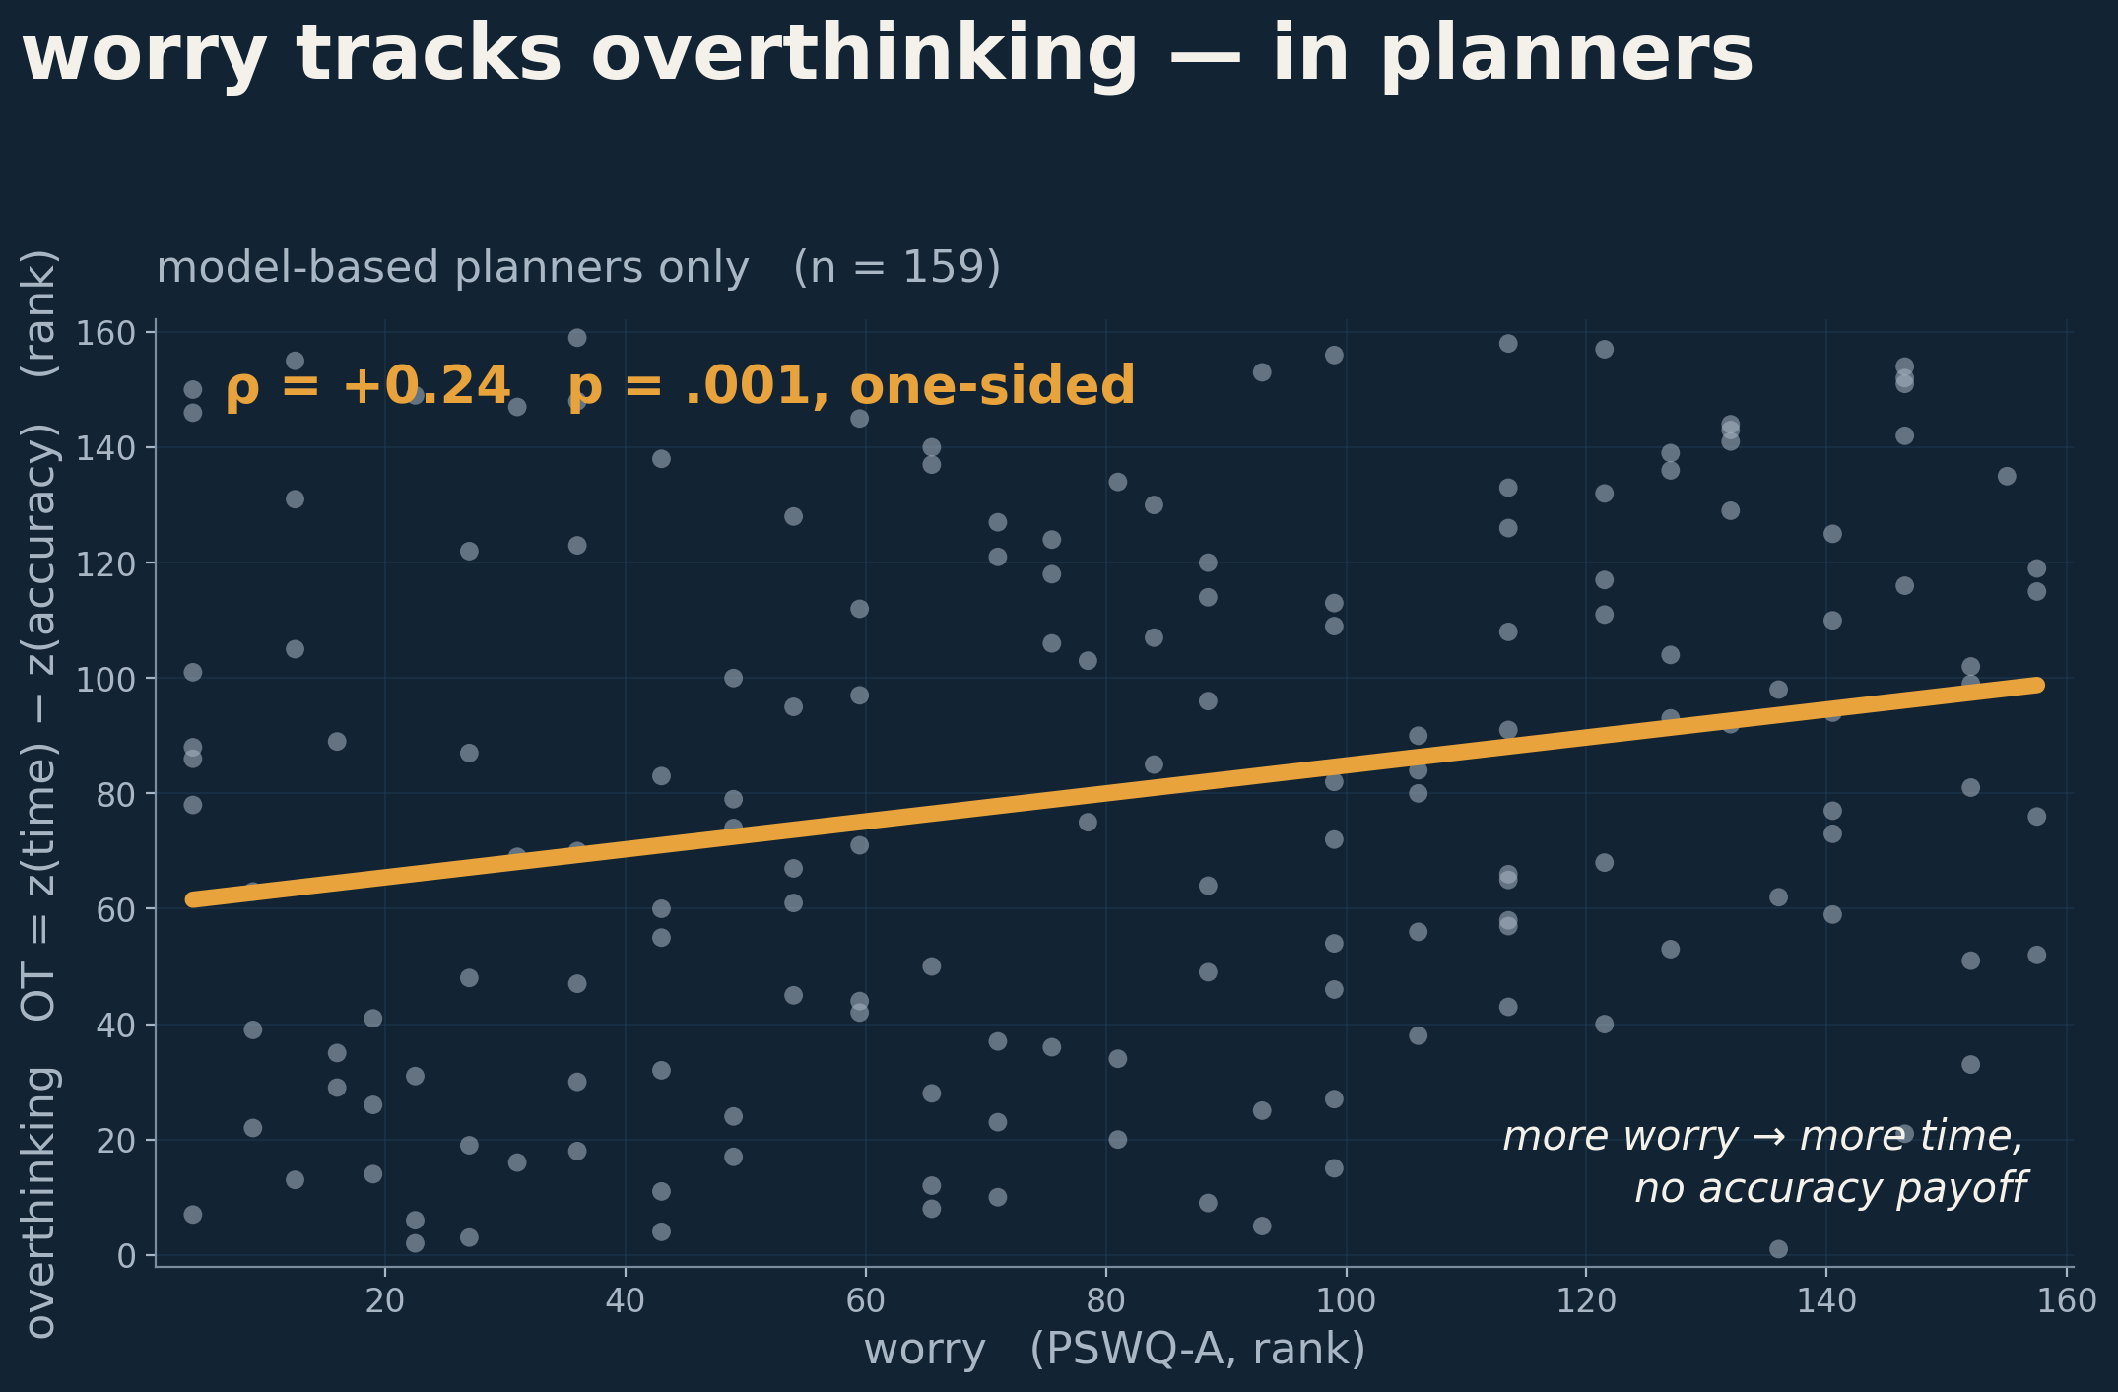
Overthinking = z( ) − z( )
deliberation
accuracy
Notes:
We were then able to operationalize overthinking as an index. demonstrate how overthinking may look like empirically. Represented by time spent deliberating and the rate of getting the optimal choice

Slide 11
Replicated Twice
N=139
N=277
Notes:
we replicated these findings ,and more, in two different independent samples

Slide 12
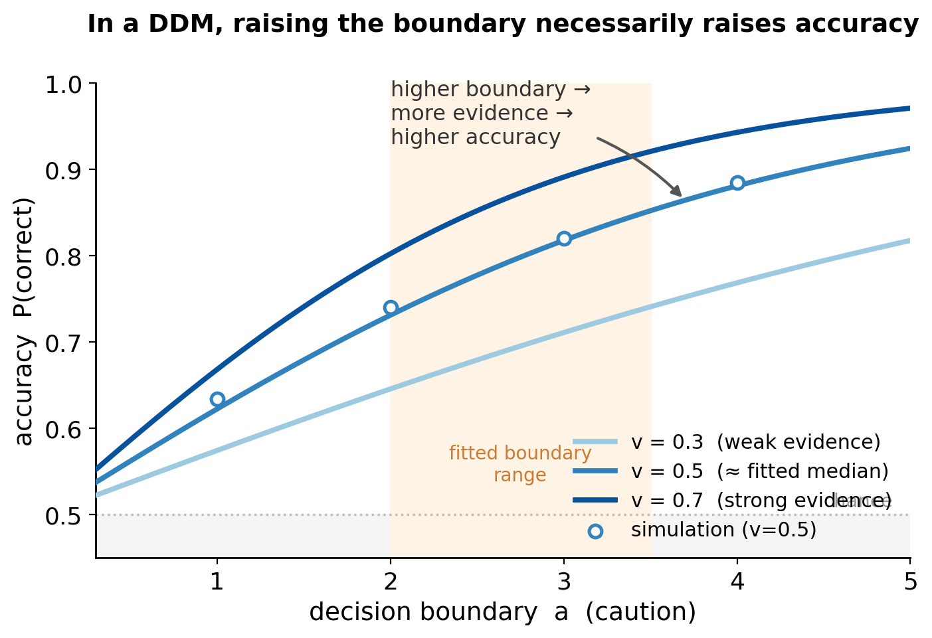
How to model internal processing?
⬆️ Boundary = ⬆️ Accuracy
Notes:
We also decided to use DDM to model participants decisions.
But In the standard model, raising the decision boundary means accumulating more evidence, which always comes with more accuracy while slowing responses.

Slide 13
Notes:
We suggested model that compose deliberation time with 3 components: the compenent that makes deliberation time inefficient is wha we call C – checking. The other Two are the model used to revaluate catched values and the other is a mentally orienting to the task objectives.

Slide 14


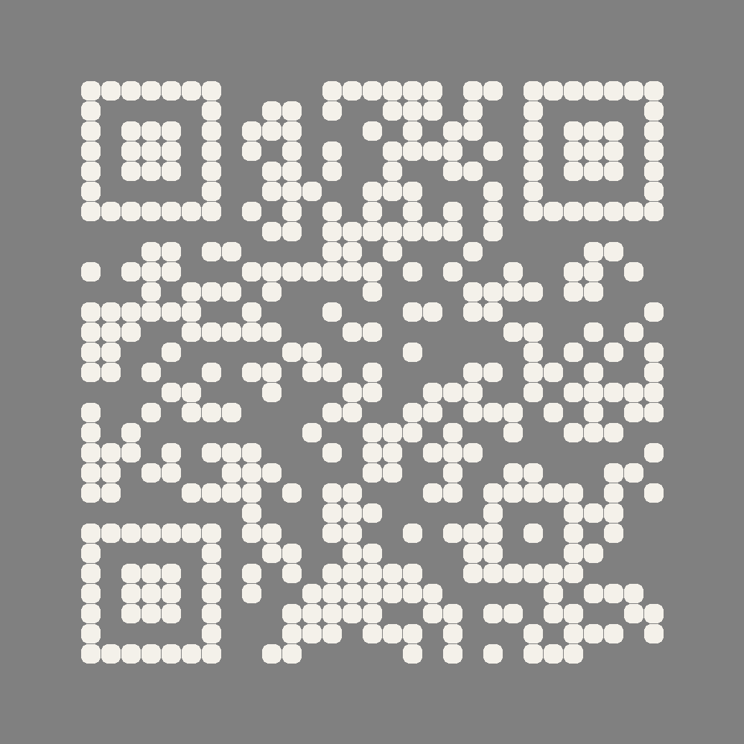
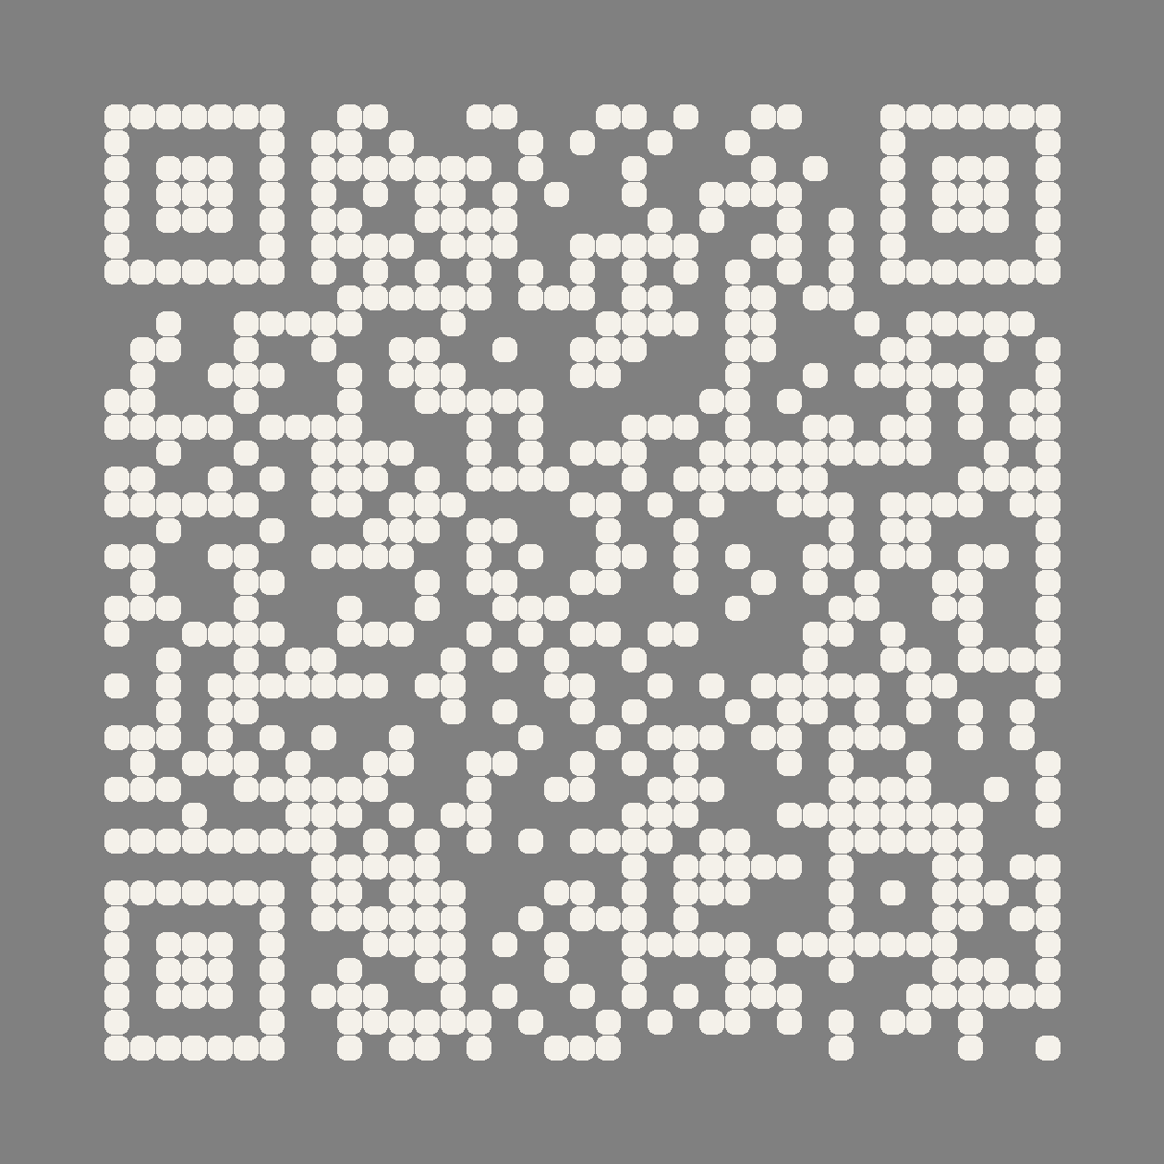
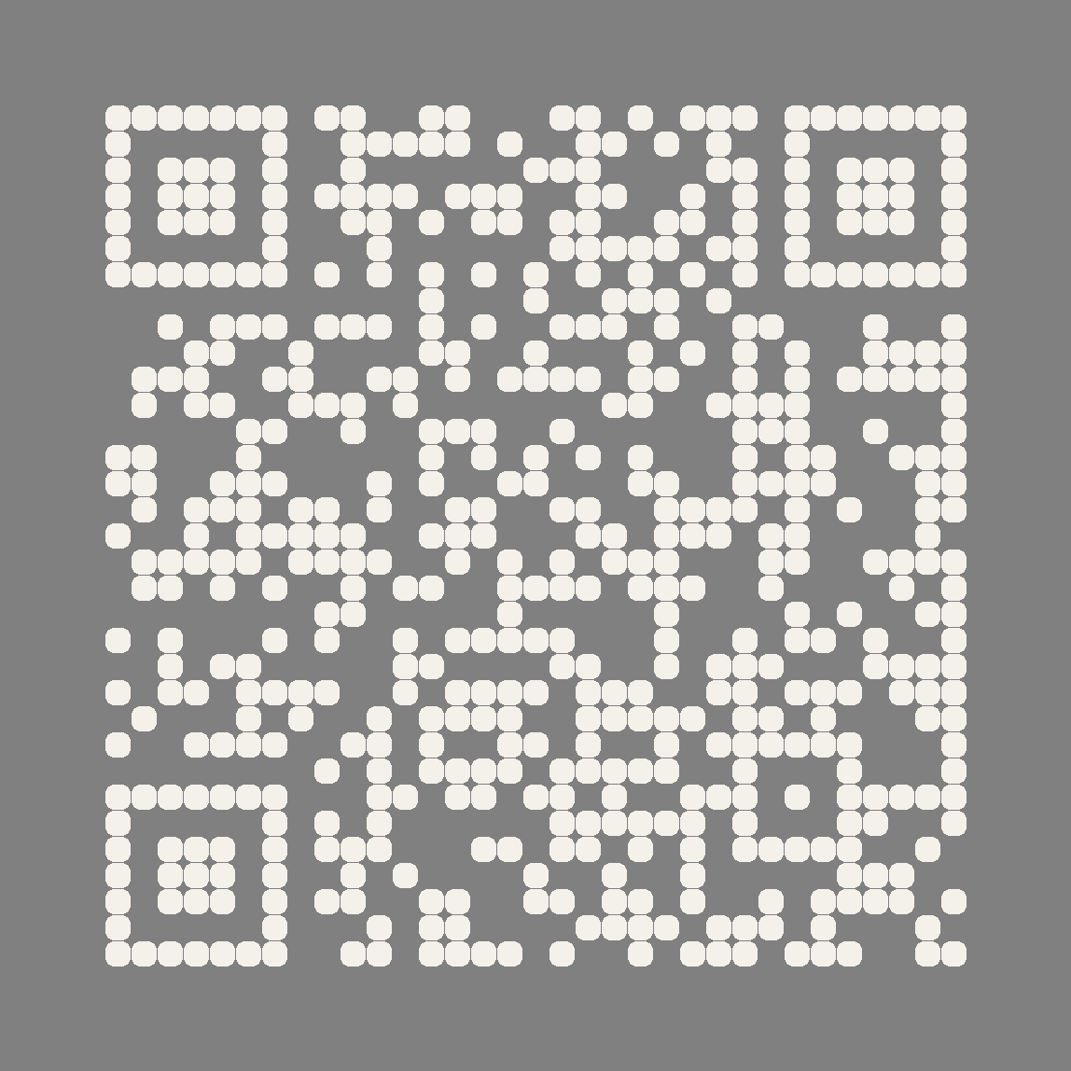
Thank you
Poster A51
15:30 – 17:30
Notes:
I’d love to discuss more about this study, please come find me today at poster

